Slide 1
NJCEP Proposed Fiscal Year 2026 Electric Vehicle Budget and Program Plans – Stakeholder Meeting
June 3, 2025
1:00 pm – 3:00 pm

Slide 2
Agenda
Welcome and Introduction
  Meeting Logistics
Process and Schedule for Comments
Overview of Budget
Public Comments

Slide 3
Meeting Logistics
Meeting will be recorded. All comments are public.
Registered speakers first.
Use “raise hand” function to request to provide oral comments
Speakers will be unmuted to provide comment; should state name and organization.
Meeting recording, PowerPoint, and comments will be available on the website.

Slide 4
Process and Schedule for Comments
Commenters are encouraged to file their comments directly to the specific dockets, Docket No. QO25040205 and QO25040206, using the “Post Comments” button on the Board’s Public Document Search tool.
Comments may also be submitted electronically to Board.Secretary@bpu.nj.gov in PDF or Word format with the subject “FY25 CRA, Budgets and Program Plans.”
Please note that these comments are considered “public documents” for purposes of the State’s Open Public Records Act. Commenters may identify information that they seek to keep confidential by submitting them in accordance with the confidentiality procedures set forth in N.J.A.C. 14:1-12.3.
Any questions may be submitted via email to Board.Secretary@bpu.nj.gov, with the same subject heading as above.
Comments will be accepted through Friday, June 6, 2025 at 5pm.

Slide 5
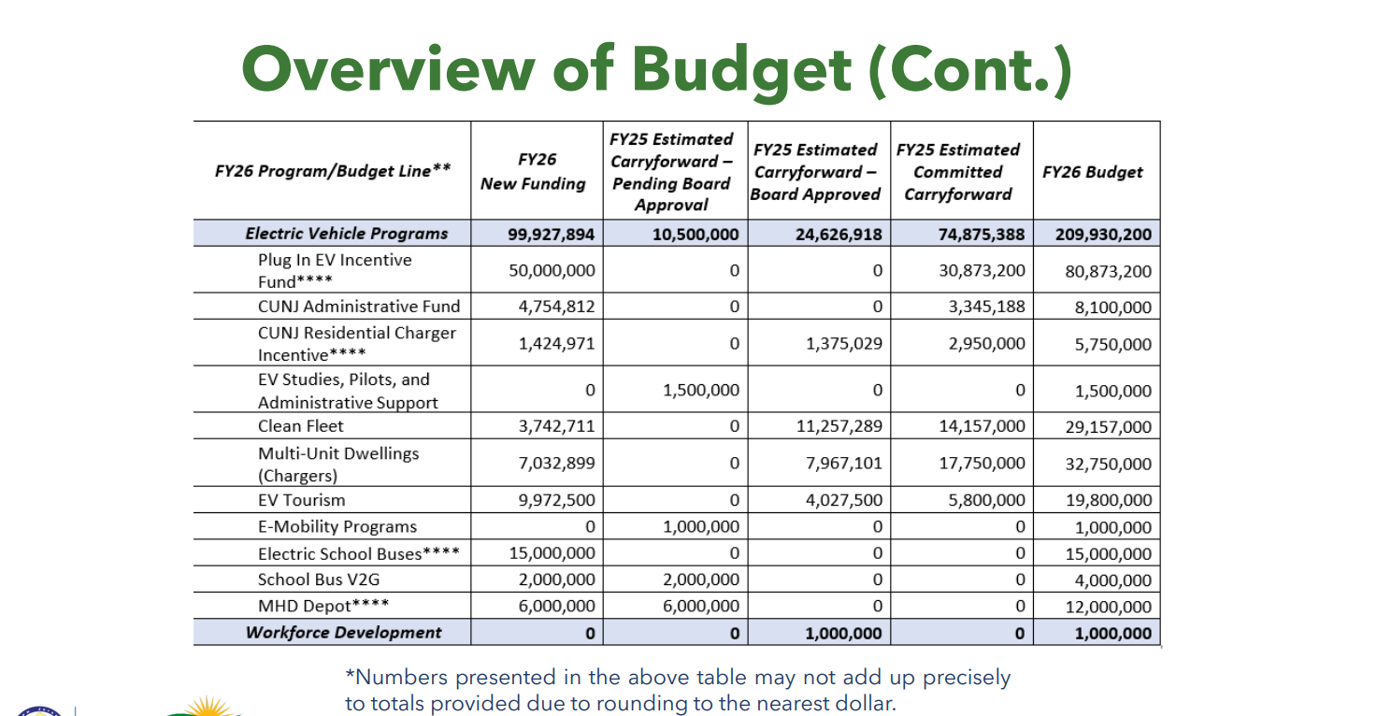
Overview of Budget
FY 26 EV Budget Proposal (In $)

Slide 6
Proposed FY26 Programs
The Electric Vehicle (EV) Budget and Programs includes:
  Charge Up Personal Vehicle Incentive
  Charge Up Residential Charge Incentive
  Clean Fleet Incentive Program
  Multi-Unit Dwelling Incentive Program
  EV Tourism Program
    EV Tourism Corridor Program
  E-Mobility Pilots
  School Buses
  MHD Depot
  Administrative Funds

Slide 7

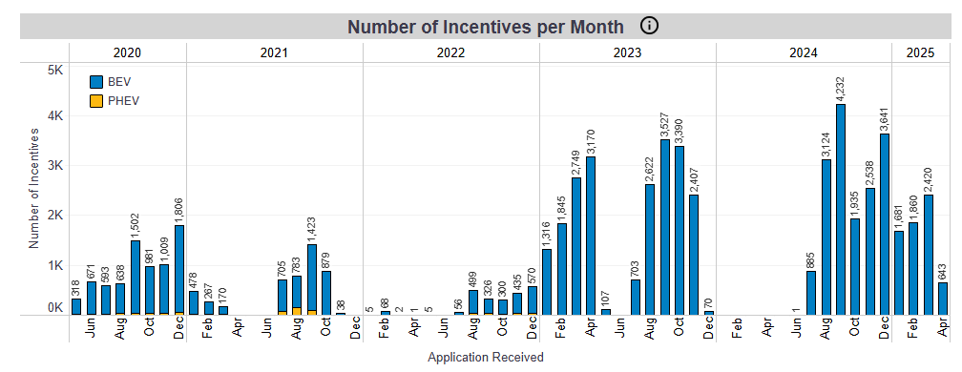
Charge Up Statistics
Chargeup.njcleanenergy.com
Notes:
Trying to drive people the statistics page of charge up website
JK updated 5/20.

Slide 8
Proposed FY26 Charge Up
  Incentive Levels -
    EVs with MSRP < $55,000 will have a fixed incentive of $1,500.
    Income qualified applicants, as identified in the Applicant Eligibility requirements, will be eligible for an additional incentive in the amount of $2,500.
    Income Qualified Applicant Eligibility
    To be eligible for the increased incentive for income eligible applicants, applicants must submit tax documentation to the Program Administrator verifying that in 2023 their Modified Adjusted Gross income (“MAGI”) met the following requirements:
      Maximum MAGI of $75,000 for single tax filers;
      Maximum MAGI of $112,500 for head of household tax filers; and
      Maximum MAGI of $150,000 for joint tax filers.
    Applicants who wish to claim the additional income-based incentive will be required to prequalify with the Program Administrator.
    Vehicles ordered in advance of the launch of the FY26 Point-of-Sale Program will not be eligible for an incentive. Notwithstanding the above, in the event that the FY25 Program does not close until June 30, 2025, vehicles ordered or purchased during the FY25 Program may be eligible for an incentive in the FY26 Program if the purchase or lease is completed during the FY26 Program.
Notes:
Will note we are working to provide an example of such notice
The MSRP cap will include all line items on the purchase or lease agreement which relate to the value of the vehicle itself (including but not limited to battery upgrades, autonomous upgrades, wheel and tire packages, audio, and infotainment system).
The MSRP cap will not include maintenance or vehicle care packages, additional vehicle accessories (i.e. first aid kits, floor mats, cargo nets, etc.), destination and delivery charges, tax, registration fees, title fees, and documentation fees since these line items do not relate to the value of the vehicle itself, but rather to the logistics, care, and maintenance of the vehicle.

Slide 9
Proposed FY26 Charge Up
Orders and Sales made in June
  Based on current funding we anticipate that the FY25 Program will not close, so there will be no closing and opening.
  New Incentive levels go into effect on July 1, 2025
  In order to ensure incentives at the FY25 level dealers should reserve funding at the time of order.
  Vehicles purchased in FY25 will receive the FY25 incentive level, as long as all other terms and conditions are followed (ie applied for with in 14 days, included at time of sale etc)

Slide 10
Proposed FY26 Charge Up
The Income- Eligibility based incentive increased to $2500
Must pre-qualify prior to purchase, prequalification may take up to 5 business days and is valid for 120 days
Dependents are not eligible for the income-qualified incentive

Slide 11
Proposed FY26 Charge Up
    Eligibility
    For vehicles that reserve funding at the time of order, the MSRP at the time of order must match the MSRP at time of purchase or lease.
    If the Program Administrator announces that the Program will close due to expending all available funds, there will not be an opportunity to reserve funds for orders made outside the normal 14-day window.
    If Dealerships or Showrooms do not intend to reserve funding at the time of order they must provide written notice to the customer that eligible vehicles will remain eligible for the incentive at the time of purchase or lease, pending availability of funds.
    Dealerships and Showrooms that do not enter orders must provide updates to the Program Administrator regarding the number of pending orders.
Notes:
Will note we are working to provide an example of such notice
The MSRP cap will include all line items on the purchase or lease agreement which relate to the value of the vehicle itself (including but not limited to battery upgrades, autonomous upgrades, wheel and tire packages, audio, and infotainment system).
The MSRP cap will not include maintenance or vehicle care packages, additional vehicle accessories (i.e. first aid kits, floor mats, cargo nets, etc.), destination and delivery charges, tax, registration fees, title fees, and documentation fees since these line items do not relate to the value of the vehicle itself, but rather to the logistics, care, and maintenance of the vehicle.

Slide 12
Charge Up Statistics
Total funding for fiscal year

Slide 13
Charge Up Statistics

Slide 14
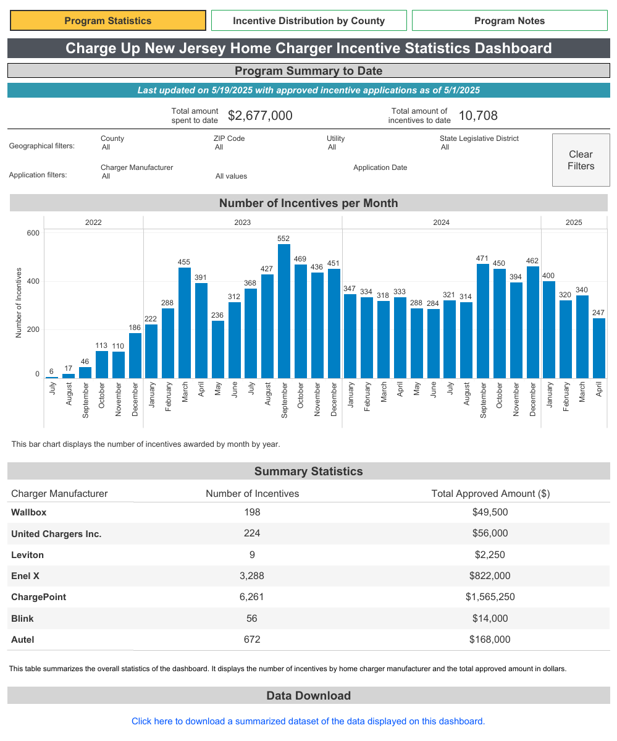
Proposed FY26 Charge Up
    There are no proposed changes to the Residential Charger Program
Chargeup.njcleanenergy.com
Notes:
Trying to drive people the statistics page of charge up website
JK updated 5/22/24

Slide 15
Proposed FY26 EV Program Requirements
To provide consistency across our programs, BPU EV Program requirements include:
  ENERGY STAR certified, as required by the Appliance Act (applicable for Level 1 & 2 chargers)
  Vehicles and chargers may not be purchased prior to application
  Meet or exceed federal uptime requirement – 97%
  Networked dual-port charger that is on a network pre-approved by the State
  Incentives may be stacked with utility make-ready incentives, up to the amounts allowed by the utility’s stipulation of settlement.
  BPU incentives may not be stacked with the New Jersey Department of Environmental Protection’s (“NJDEP”) It Pay$ to Plug In Program for the same charger
Notes:
Changes to programs are in green

Slide 16
Proposed FY26 Clean Fleet
For state and local government entities including colleges, towns, schools and non-profits
Now administered by CSE
Incentive levels:
  $4,000 for an EV
  $5,000 L2 Public Charger
  $4,000 L2 Fleet Charger + 50% (up to $5,000) for Make Ready
  Fast Chargers:
    $60,000 (50-100 kW)
    $100,000 (100-200 kW)
    $180,000 (200 kW+)
    + 50% (up to $50,000) for Make Ready for Fleet Fast Chargers
  $10,000 for a Class 2b- 6 EV
  50% bonus for Overburdened Municipalities
  NEW this year Off-Road Equipment
Notes:
Changes to programs are in green

Slide 17
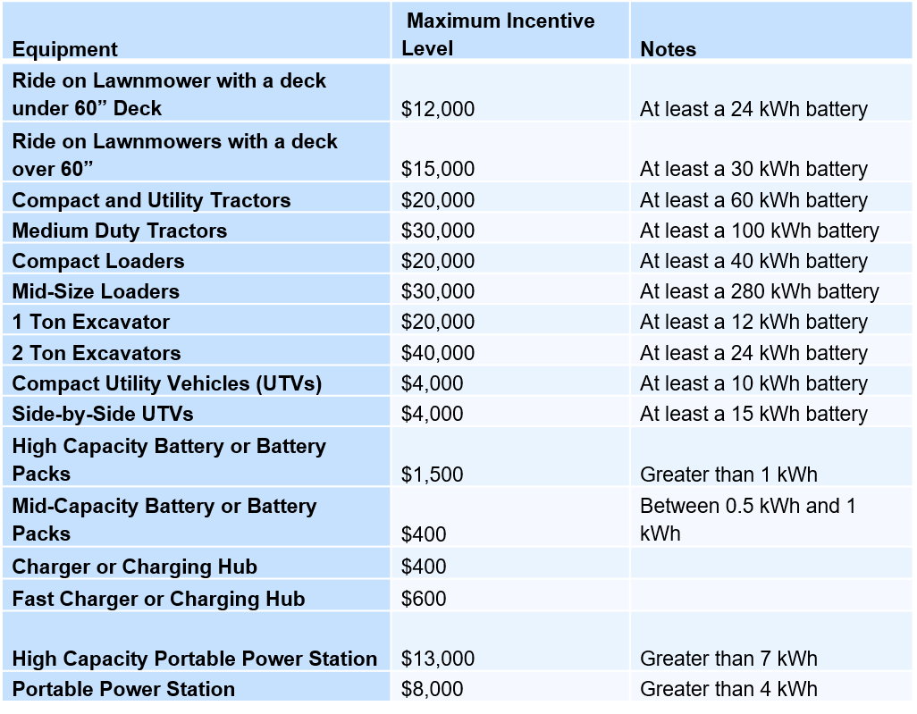
Proposed FY26 Clean Fleet
Full Off-Road Incentive:

Slide 18
Proposed FY26 Clean Fleet
Partial/Demo Off-Road Incentive:
Equipment | Maximum Incentive Level | Notes
Equipment included in the Satisfactory category that has a smaller kWh battery | 50% of the full incentive
Wheelbarrow | $1,000

Slide 19
Clean Fleet Statistics
Much of the carry over included in the budget is to fund the already awarded grants from previous years.
Fiscal Year | Amount Awarded | Amount Paid Out
FY22 | $2,267,000 | $681,669
FY23 | $5,902,000 | $2,203,944
FY24 | $4,229,000 | $131,000
FY25 | $2,429,000 | $6,000

Slide 20
Clean Fleet Statistics
Notes:
Will note that supply chain and procurement issues have slowed this program. But state starts accepting bids on chargers June 23rd

Slide 21
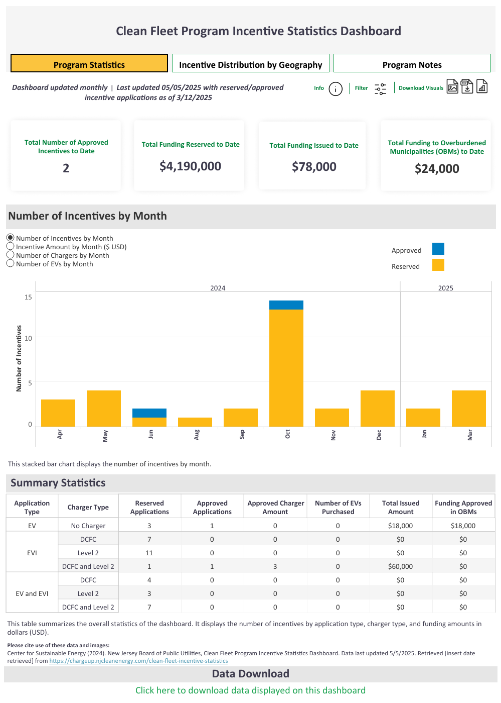
Clean Fleet Statistics

Slide 22
Proposed FY26 MUD
For MUDs with more than 5 units and dedicated off-street parking
Now administered by CSE
$4,000 per charger
Maximum award based on size of development
MUDs located in an Overburdened Municipality eligible for 50% bonus
Eligible applicants that are deed restricted, 100% affordable (low- and moderate-income) housing may also be eligible for a 50% bonus, Applicants may only receive one bonus
Notes:
Green is changes

Slide 23
MUD Statistics
Much of the carry over included in the budget is to fund the already awarded grants from previous years.
Fiscal Year | Amount Awarded | Amount Paid Out
FY22 | $5,075,500 | $1,946,183
FY23 | $6,162,500 | $969,958
FY24 | $6,354,661 | $1,008,984
FY25 | $2,792,000 | $380,000

Slide 24
MUD Statistics
Notes:
Will note supply chain issues impacted applications

Slide 25
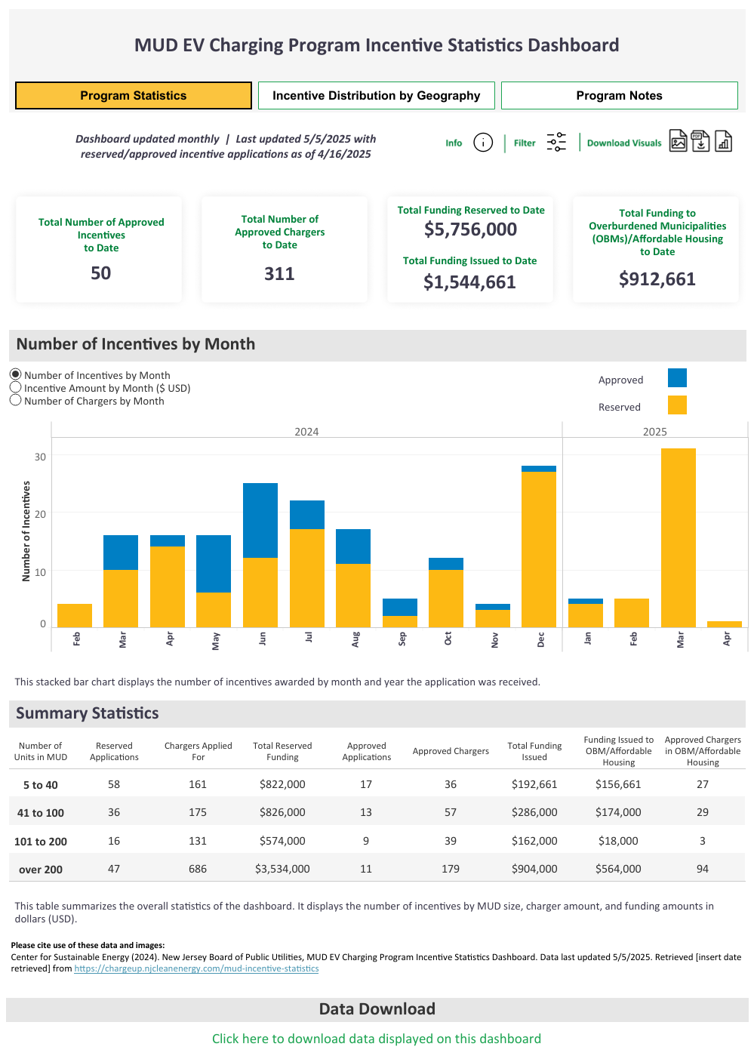
MUD Statistics

Slide 26
Proposed FY26 EV Tourism
For tourism locations including downtowns, parks, hotels, historic sites
Incentive levels:
  $5,000 for L2
  $50,000 for Fast Chargers

Slide 27
EV Tourism Statistics
Much of the carry over included in the budget is to fund the already awarded grants from previous years.
Fiscal Year | Amount Awarded | Amount Paid Out
FY22 | $5,236,000 | $1,059,874
FY23 | $760,000 | $208,820
FY24 | $1,155,000 | -

Slide 28
EV Tourism Statistics
Notes:
Will note supply chain issues impacted applications

Slide 29
EV Tourism Corridor Program
For businesses, government, and non-profits within 1 mile of eligible corridor, and for hotels within 3 miles of eligible corridor.
Incentive levels:
  Level 2 Charger: $5,000 (Hotels only)
  50-100 kW Fast Charger: $60,000
  100-200 kW Fast Charger: $100,000
  200 kW+ Fast Charger: $180,000

Slide 30
Proposed FY26 E-Mobility
This will fund future e-mobility programming as developed by Staff over the course of FY26, this could include:
  Recommendations from “New Jersey Overburdened Communities Electric Vehicle Affordability Program Study”
  E-bike and/or E-scooter incentives
  E-ride share charging incentives
  Other pilot programs associated with e-mobility options
Notes:
Tried to add in more “things” per GO conversation

Slide 31
Proposed FY26 School Bus Funding
This line represents:
  $15 million legislatively required to be provided to DEP in FY24
  $4 million for potential V2G incentives in conjunction with the DEP School Bus Program
Notes:
Tried to add in more “things” per GO conversation

Slide 32
Proposed FY26 MHD Depot
This will fund the legislatively mandated MHD Depot Demonstration Program, work on designing the program began in FY25
Notes:
Tried to add in more “things” per GO conversation

Slide 33
PUBLIC COMMENTS

Slide 34
THANK YOU

